Slide 1


Diabetes Awareness
NOV 2021
PREDICTING DIABETES
Presented By:
Sultanah Aldossari
Rawan Alharbi

Slide 2



Introduction
CONTENT OUTLINE
Dataset
Expolarity Data Analysis
Data Pre-processing
Model Building and Evaluation
Conclusion

Slide 3


PROBLEM STATEMENT
Diabetes is a common chronic disease and poses a great threat to human health.
It can lead to chronic damage and dysfunction of various tissues. Therefore, The earlier diagnosis is obtained, the much easier we can control diabetes.
Our aim is to predict diabetes using Classification techniques.

Slide 4

DATASET
Pregnancies
Glucose
Blood Pressure
Skin Thickness
Insulin
BMI
Diabetes Pedigree Function
Age
Outcome

Slide 5
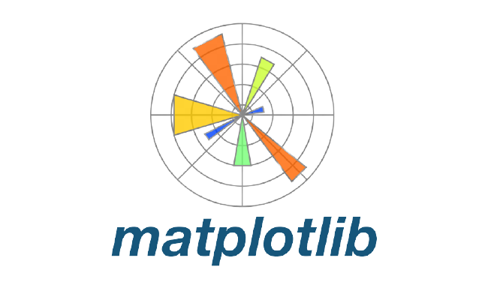


TOOLS

Slide 6

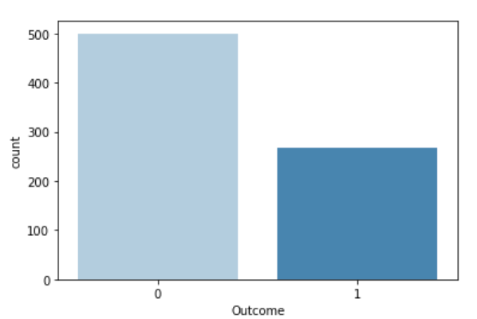
EXPOLARITY DATA ANALYSIS

Slide 7
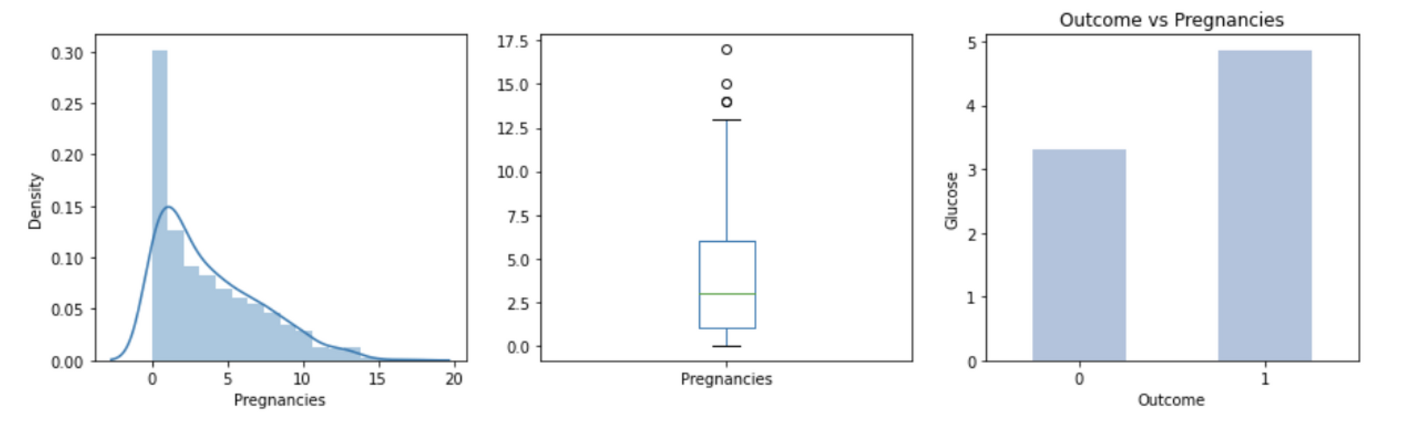
EXPOLARITY DATA ANALYSIS

Slide 8
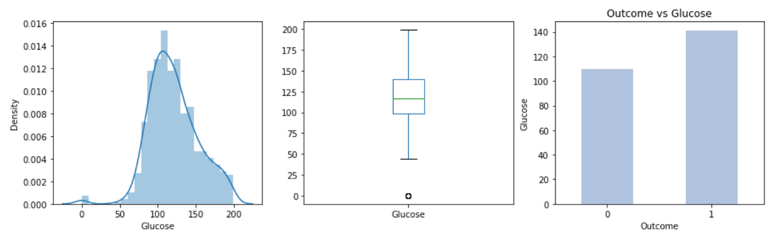
EXPOLARITY DATA ANALYSIS

Slide 9
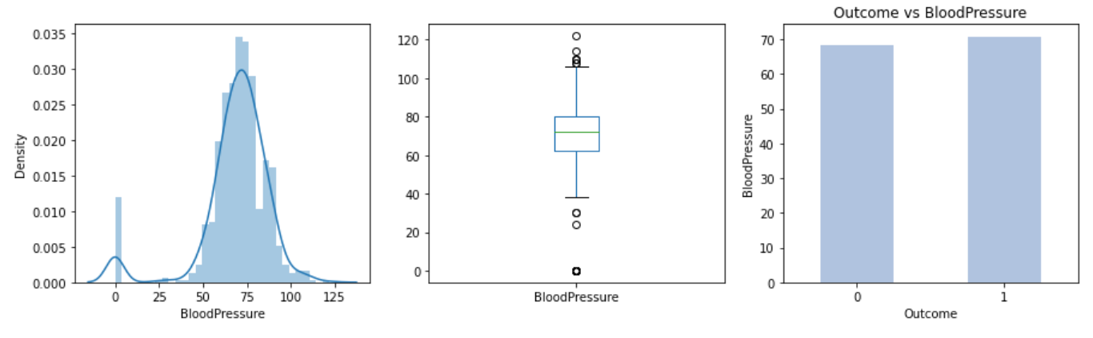
EXPOLARITY DATA ANALYSIS

Slide 10
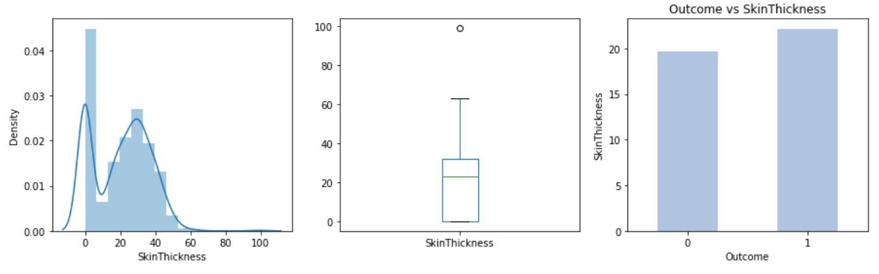
EXPOLARITY DATA ANALYSIS

Slide 11
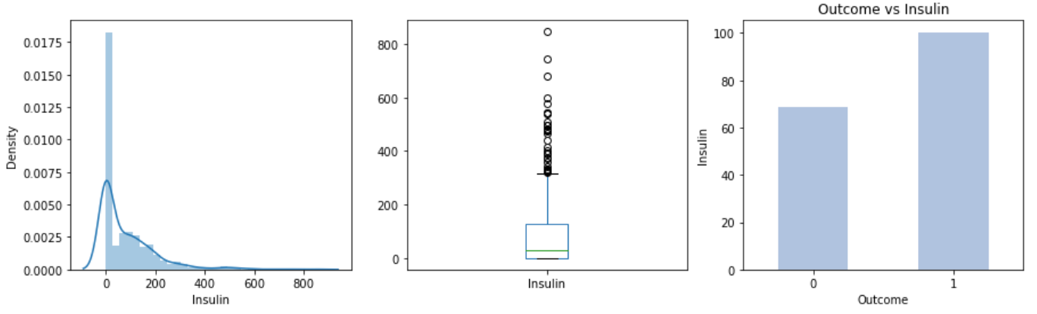
EXPOLARITY DATA ANALYSIS

Slide 12
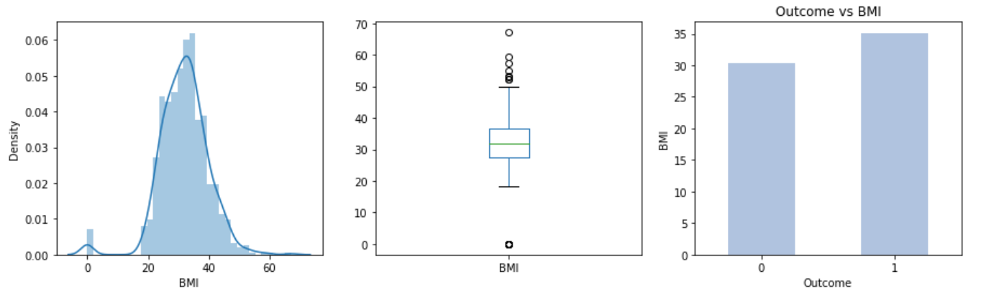
EXPOLARITY DATA ANALYSIS

Slide 13
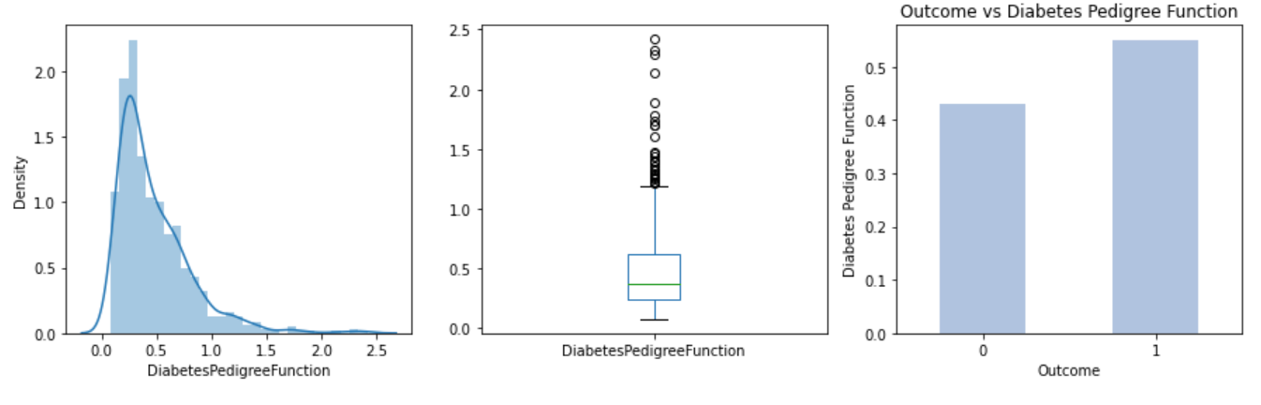
EXPOLARITY DATA ANALYSIS

Slide 14
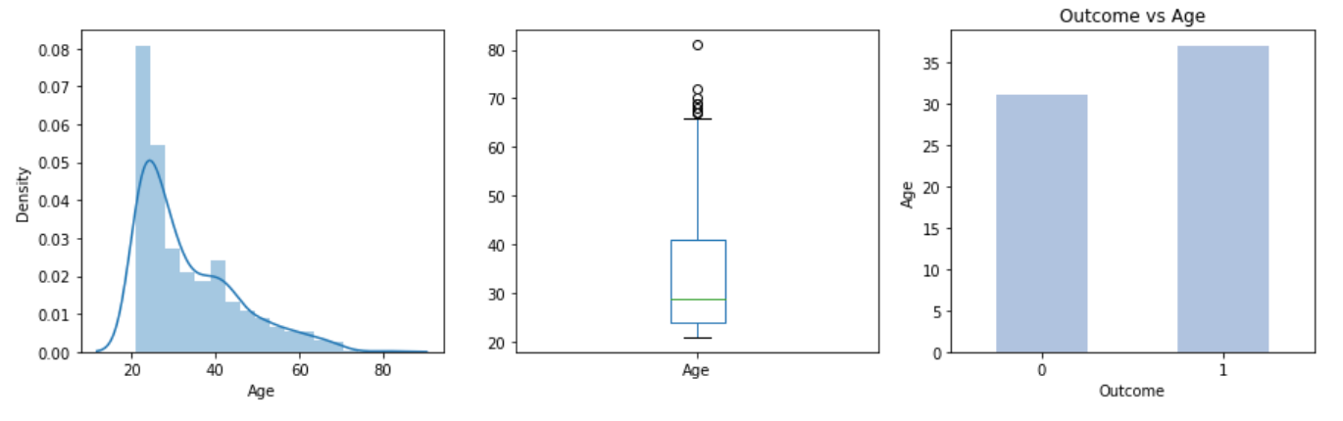
EXPOLARITY DATA ANALYSIS

Slide 15
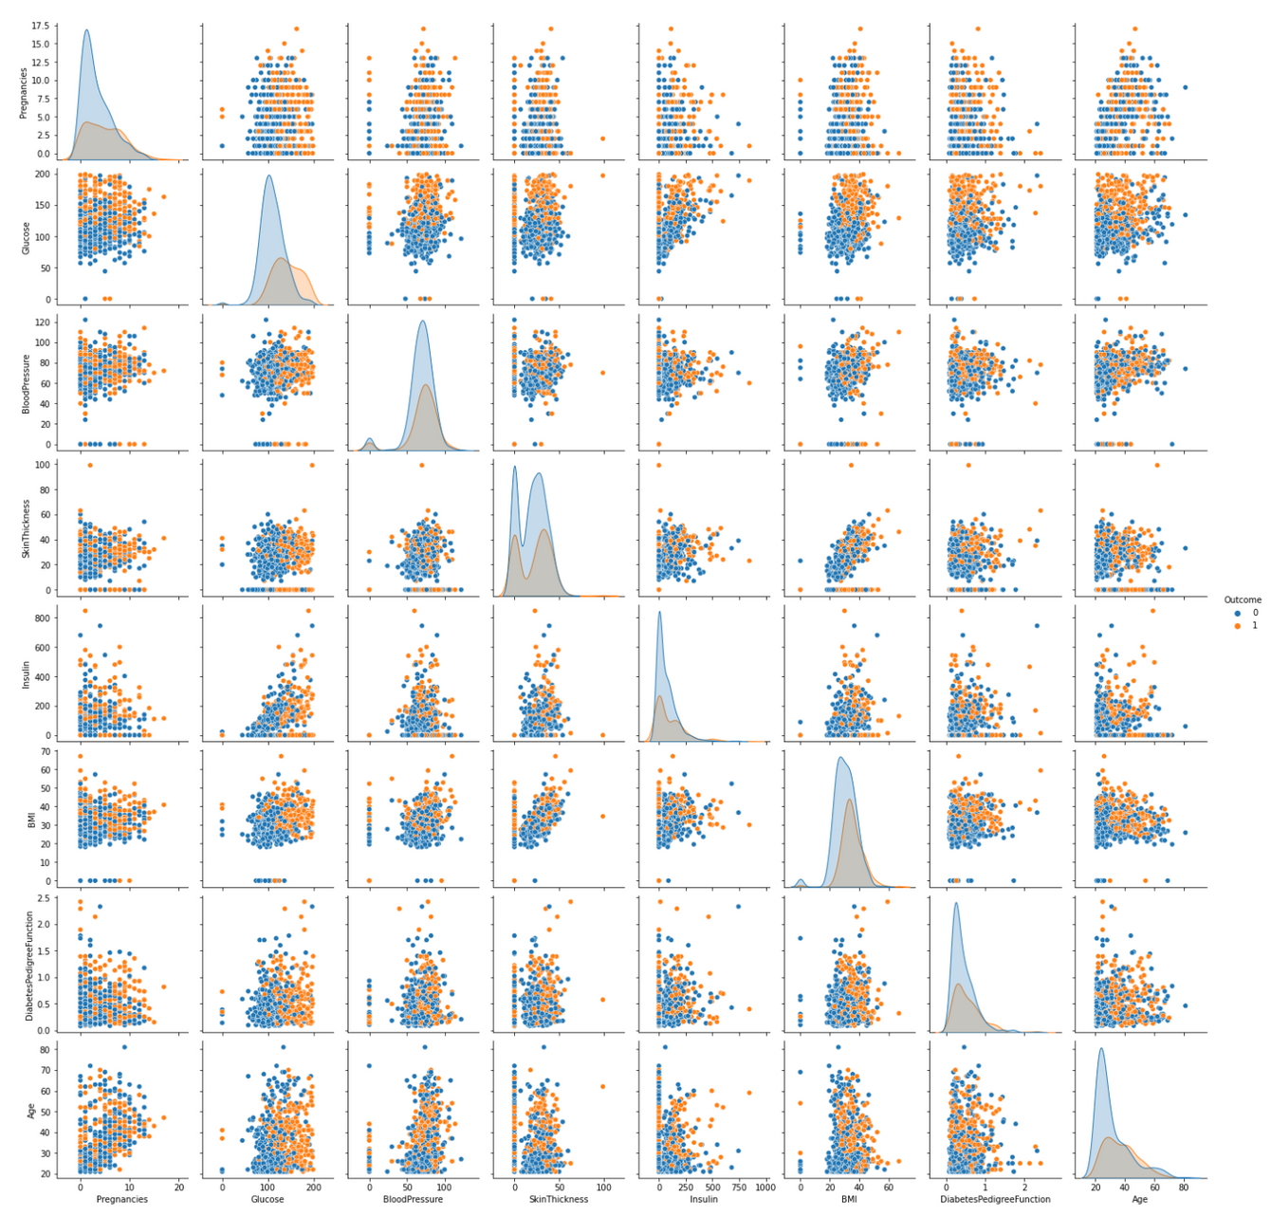
CONT: EDA
Relationship between target and predictors

Slide 16

DATA PRE-PROCESSING
Split into Train and Test
Outliers Handling
Handle Zeros
Scaling Data
Notes:
Good morning, everyone, I'm going to talk about how did we prepared our data for modeling. At first, we captured outliers through the box plots of our feature, and we handled them using LOCAL OUTLIER FACTOR, its a method that computes the local density deviation of data points with respect to its neighbors. Second, we seems to have zero values, so we imputed them with mean. We scaled our data with standardscaler and finally we splited the data into train and test for modeling.

Slide 17

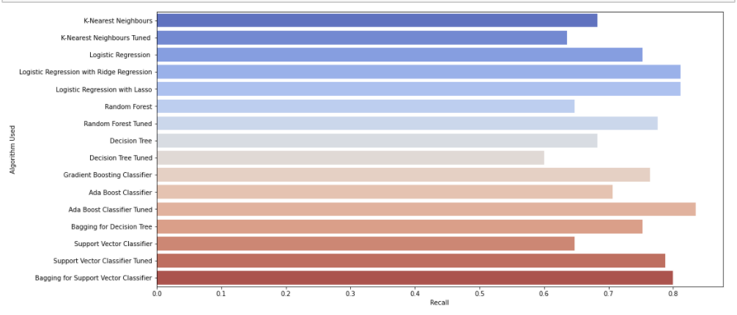
MODEL EXPERIMENTS & EVALUATION:
Notes:
A big part of machine learning is classification — we want to know what class (a.k.a. group) an observation belongs to.
Data science provides a plenty of classification algorithms and we have used different ML techniques such as logistic regression, support vector machine, Random Forest classifier, and decision trees. The performances of all algorithms are evaluated based on recall because we wanted to decrease the number of FN due to the high impact on diabetes patients. Results obtained show Ada boost classifier outperforms with the highest recall of 84% comparing to other algorithms. These results are verified using Receiver Operating Characteristic (ROC) curves with 76%

Slide 18
Ada Boost
Recall = 84%
AUC = 76%
BEST PREFORMED ALGORITHM:
Logistic Regression L2
Recall = 81%
AUC = 80%
Logistic Regression L1
Recall = 81%
AUC = 81%

Slide 19
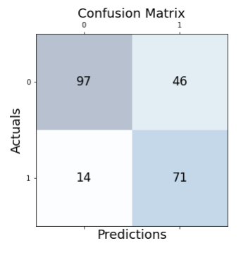
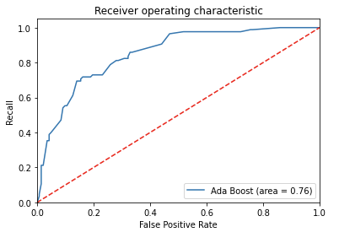
ADA BOOST CLASSIFIER
Confusion matrix & ROC Curve Plot

Slide 20
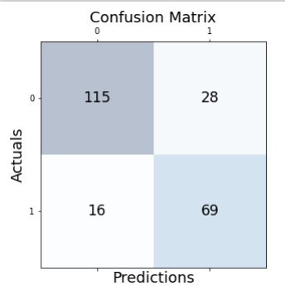
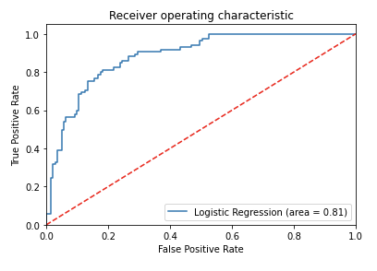
LOGISTIC REGRESSION L2:
Confusion matrix & ROC Curve Plot

Slide 21
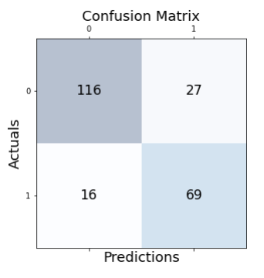
LOGISTIC REGRESSION L1
Confusion matrix & ROC Curve Plot

Slide 22
DIABETES PREDICTION APP

Slide 23



FUTURE WORK
Collect more data about diabetes and analyze them
Build a system that helps people in getting an initial information
For better predictions

Slide 24

DIABETES
THANK YOU FOR LISTENING!

